Slide 1
Popped out O-ring RCA
October

Slide 2
Abbreviations
Problem statement
Frequency of occurrence as reported
Hypothesis
Impact
Action points

Slide 3

List of Abbreviations
KP- KOKOpoint
SMV- Smartvalve

Slide 4
Problem statement
Popped out 30x2mm O-ring for dock part 3

Slide 5
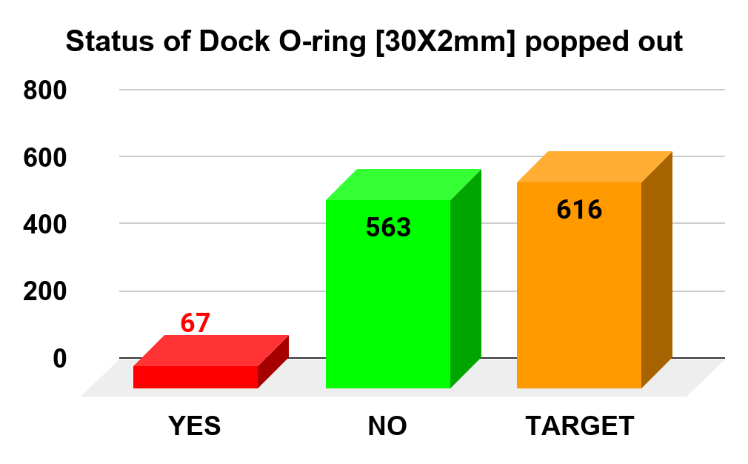
Frequency of occurrence - maintenance report
YES | NO | TARGET
67 | 563 | 616
11% of visited KPs
Source Data

Slide 6
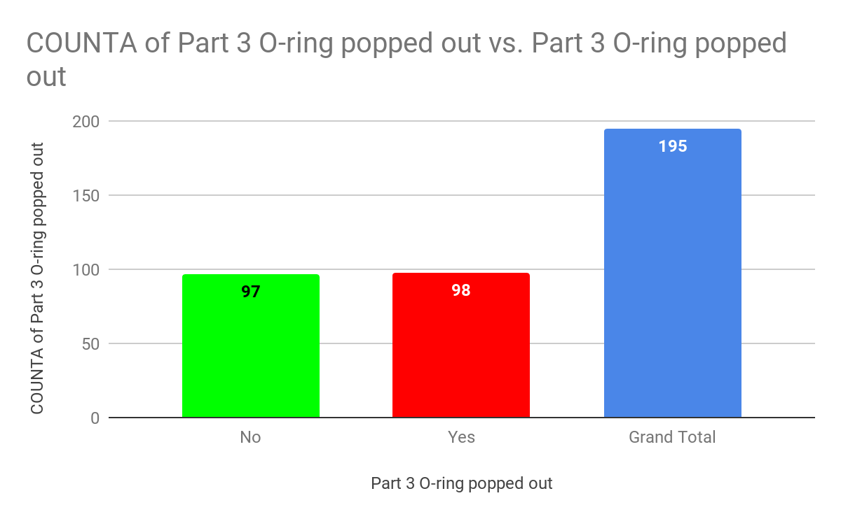
Frequency of occurrence - In house repair report
Part 3 O-ring popped out | COUNTA of Part 3 O-ring popped out
No | 66
Yes | 68
Grand Total | 134
98 of 195 KP canister docks repaired as from 4th August
Source Data

Slide 7
Hypothesis
Canister issue from the last batch shipment to be checked
Heat capacity of the SS parts to be tested
The SS part 3 groove might be smaller
The SS part 3 groove is smoother compared to the plastic part 3 (coefficient of friction)
KPs recurrence to be tracked to determine if this is a factor
Inhouse QC for the final dock at least 30%

Slide 8
Impact
First nothing happens when all other factors remain constant
Flooding SMV when the DV is faulty and not closing completely

Slide 9
Action points
Daniel - ensure SMV and dock housing integrate to achieve concentric nature of dock part 1 and the dock cover
Steve - collection of defective canisters, test with them and analyze neighborhoods where the issue occur
Yasin - specify which 0-ring popped out in deployment form response/use similar wording and KOKO naming standard for parts
Sam - 30% QC goal
Ceesay - lab tests i.e check heat capacity and research on solution liaise also with India team

